Slide 1
Introduction to C++

Slide 2
History of C++
C++ is a multi-paradigm programming language that supports object oriented programming (OOP) created by Bjarne Stroustrup in 1983 at Bell labs, C++ is an extension of C programming and the programs written in C language can run in C++ compiler.
The development of C++ actually began four years before its release, in 1979. It did not start with the name C++. Its first name was C with classes.

Slide 3
History of C++ (Cont.)
In the late part of 1983, C with classes was first used for AT&T's internal programming needs. Its name was changed to C++ later in the same year.
It is of course also used in a wide range of other application domains, notable graphics programming. C++ supports inheritance through class derivation. Dynamic binding is provided by Virtual class function.

Slide 4
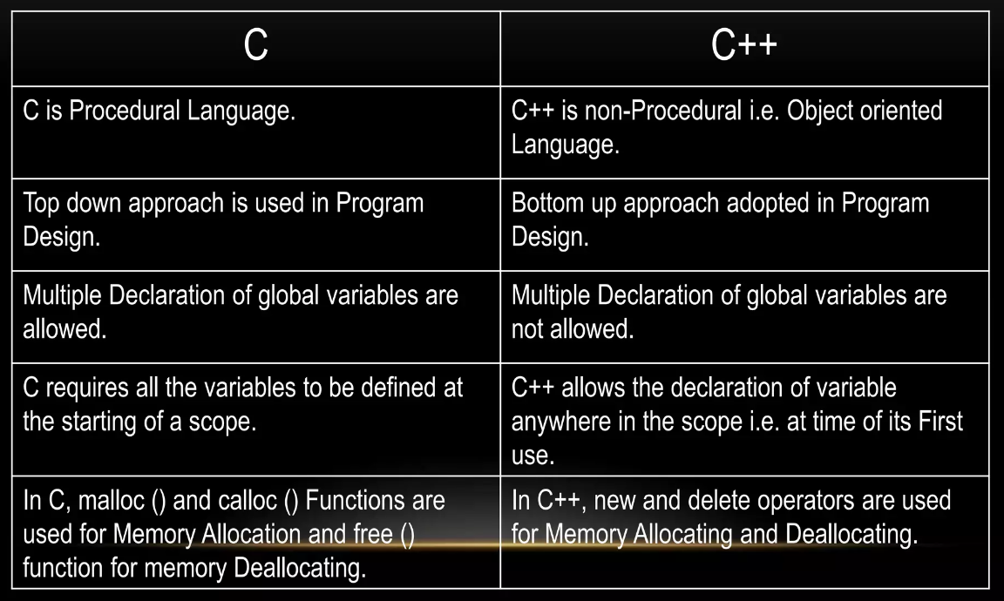
Difference between C++ and C

Slide 5
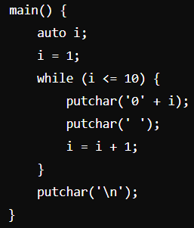
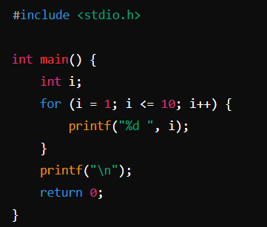
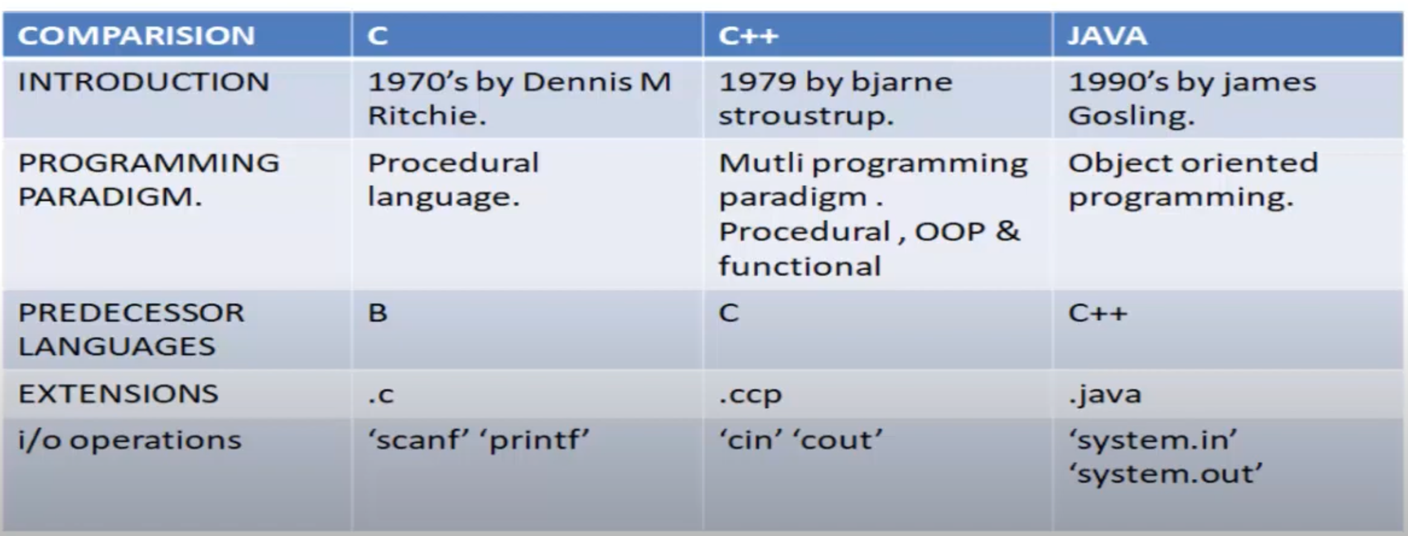
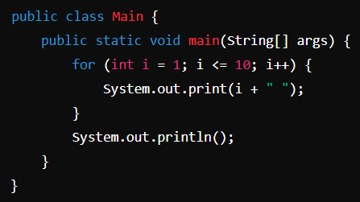
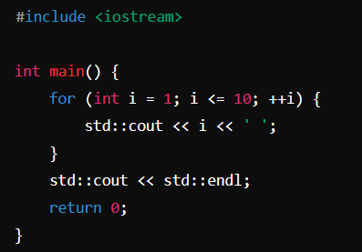
Difference between C, C++ and Java

Slide 6
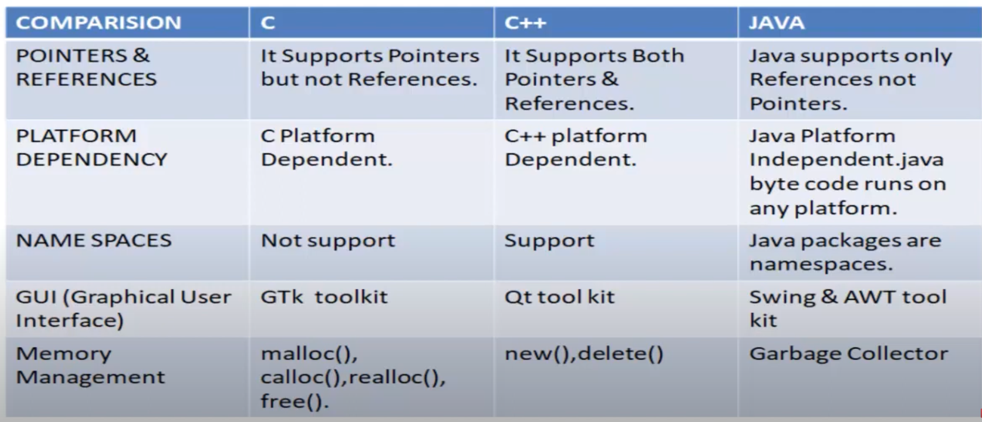
Difference between C, C++ and Java

Slide 7
Use of C++
C++ is used by programmers to develop computer software
It is used to create general system software
Used to build drivers for various computer devices
Software for servers and software for specific applications
Used in the creation of video games.

Slide 8
Advantage of C++
C++ is relatively-low level and is a systems programming language.
It has a large community.
It has a relatively clear and mature standard.
Modularity
Reusability and readability

Slide 9
Disadvantage of C++
Data is global or local.
It emphasis on instructions but not on data.
It can be generally heavy if not careful.
Data is global and global data does not have security.

Slide 10
Standard Libraries
The C++ Standard Library can be categories into two parts:
The standard function library:
This library consists of general-purpose, stand-alone functions that are not part of any class. The function library is inherited from C.
The object-oriented class library:
This is a collection of classes and associated functions.
Standard C++ library incorporates all the standard c libraries also, with small additions and changes to support type safety.

Slide 11
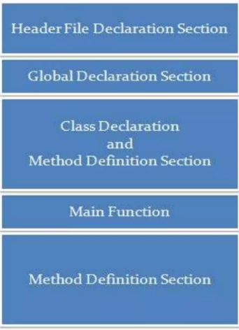
Structure of C++

Slide 12
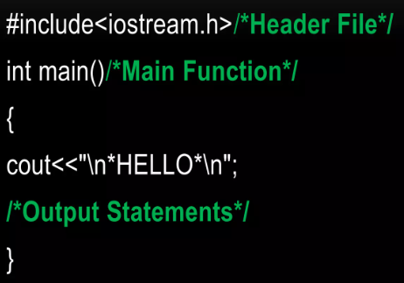
Simple Program C++

Slide 13
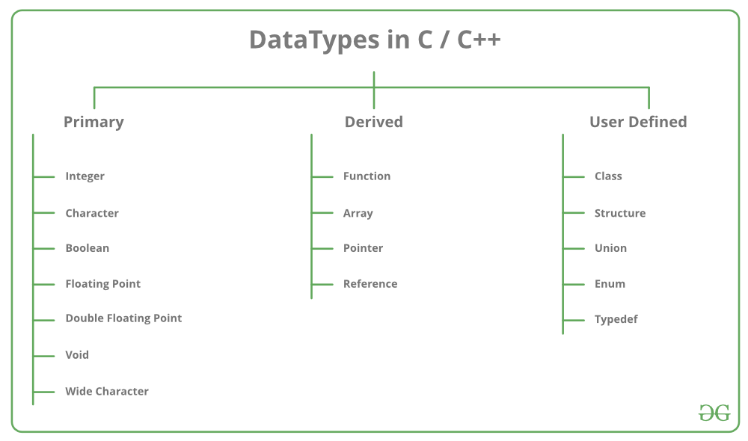
256 Value
65536 Value

Slide 14
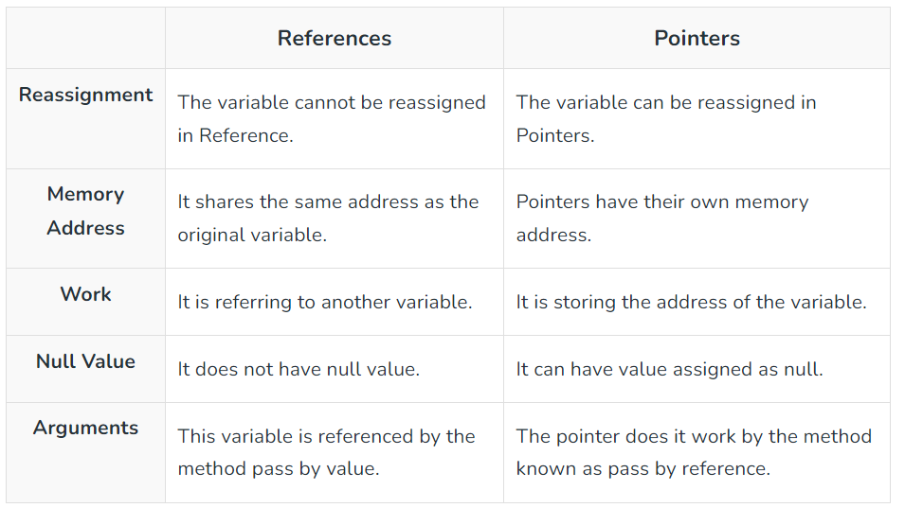
Reference vs Pointers

Slide 15
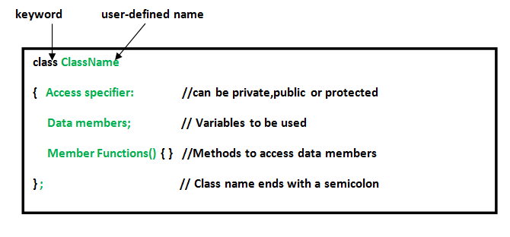
Class
A user-defined data type, which holds its own data members and member functions, which can be accessed and used by creating an instance of that class

Slide 16
Structure
A structure creates a data type that can be used to group items of possibly different types into a single type.
struct address {
char name[50];
char street[100];
char city[50];
char state[20];
int pin;
};

Slide 17
Union
Union: Like Structures, union is a user defined data type. In union, all members share the same memory location.
union test {
int x, y;
};

Slide 18
C++ Datatypes (Enumeration)
Mainly used to assign names to integral constants, the names make a program easy to read and maintain.
// An example program to demonstrate working
// of enum in C
#include<stdio.h>
enum week{Mon, Tue, Wed, Thur, Fri, Sat, Sun};
int main()
{
enum week day;
day = Wed;
printf("%d",day);
return 0;
}

Slide 19
C++ Datatypes (Type Def)
C++ allows you to define explicitly new data type names by using the keyword typedef.
Using typedef does not actually create a new data class, rather it defines a name for an existing type.
This can increase the portability(the ability of a program to be used across different types of machines; i.e., mini, mainframe, micro, etc; without much changes into the code)of a program as only the typedef statements would have to be changed.

Slide 20
C++ Datatypes (Type Def)
// C++ program to demonstrate typedef
#include <iostream>
using namespace std;
// After this line BYTE can be used
// in place of unsigned char
typedef unsigned char BYTE;
int main()
{
BYTE b1, b2;
b1 = 'c';
cout << " " << b1;
return 0;
}

Slide 21
C++ Datatypes (Enumeration)
// An example program to demonstrate working
// of enum in C
#include<stdio.h>
enum week{Mon, Tue, Wed, Thur, Fri, Sat, Sun};
int main()
{
enum week day;
day = Wed;
printf("%d",day);
return 0;
}

Slide 22
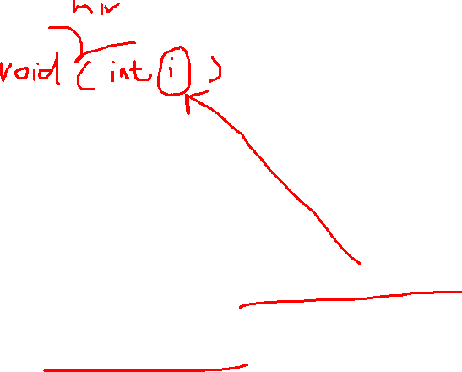
C++ Variable Scope
A scope is a region of the program and broadly speaking there are three places, where variables can be declared:
Inside a function or a block which is called local variables,
In the definition of function parameters which is called formal parameters.
Outside of all functions which is called global variables.

Slide 23
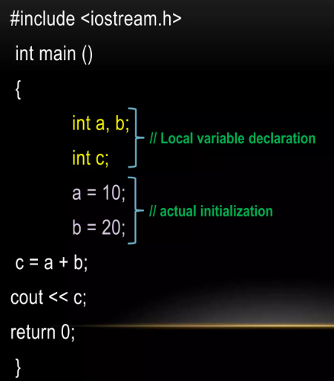
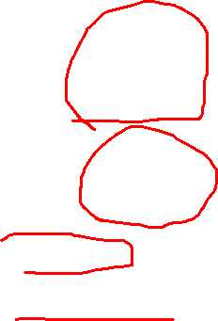
Local Variables

Slide 24
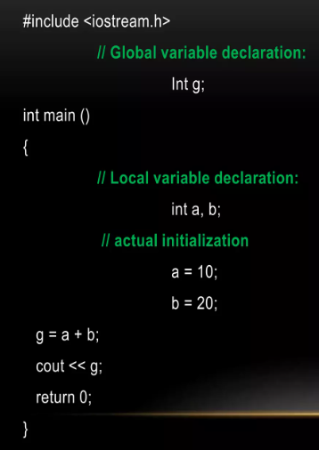
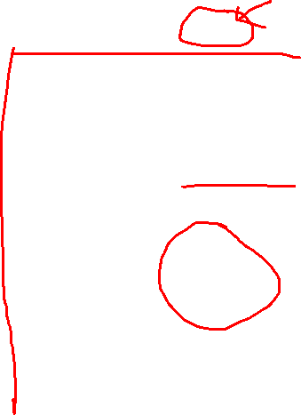
Global Variables

Slide 25
Operators
Arithmetic operators
Relational operators
Logical operators
Bitwise operators
Assignment operators

Slide 26
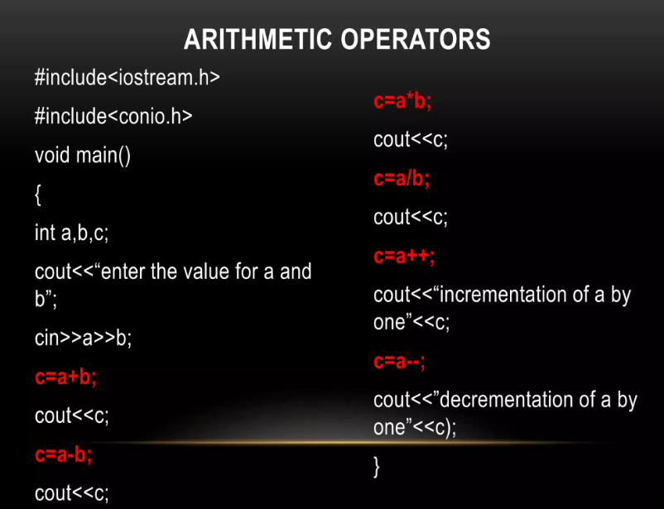

Slide 27
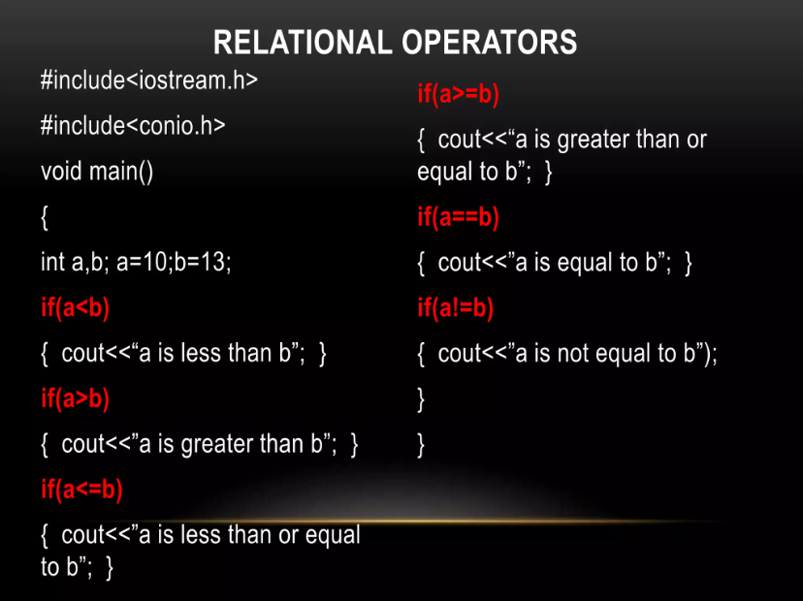

Slide 28
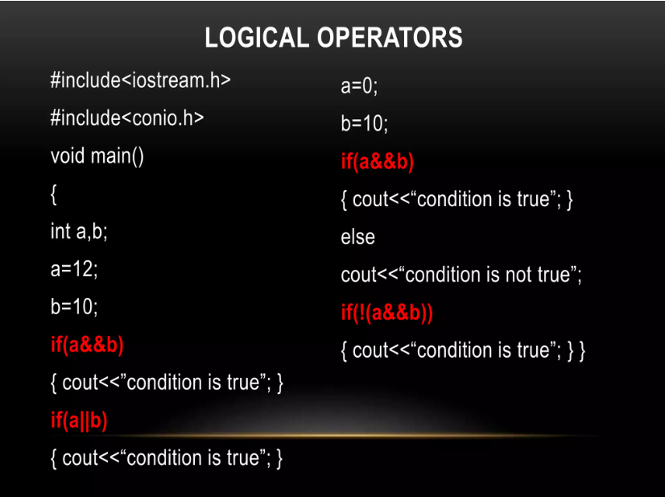


Slide 29
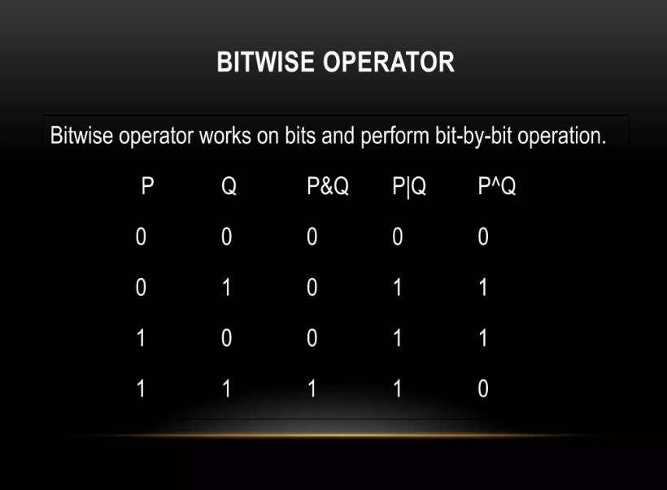


Slide 30
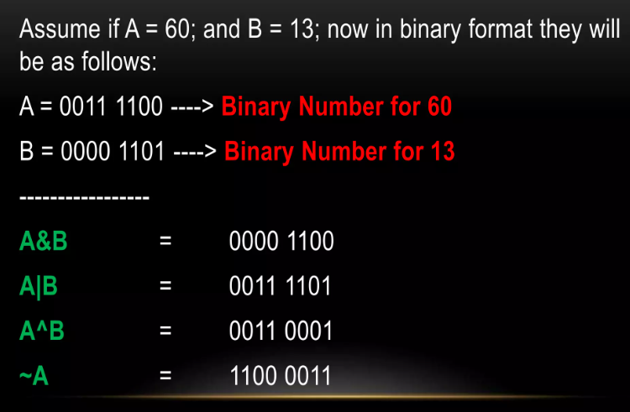
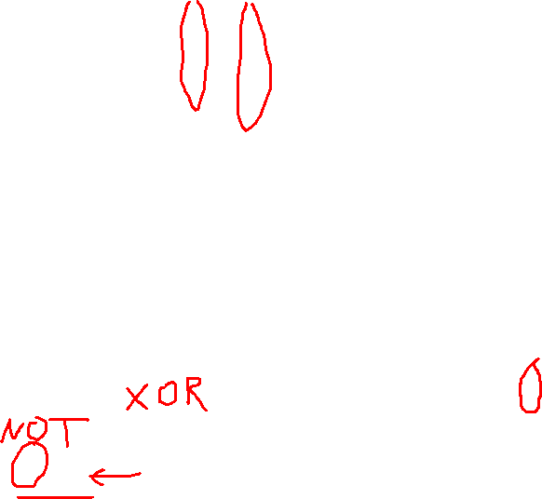

Slide 31
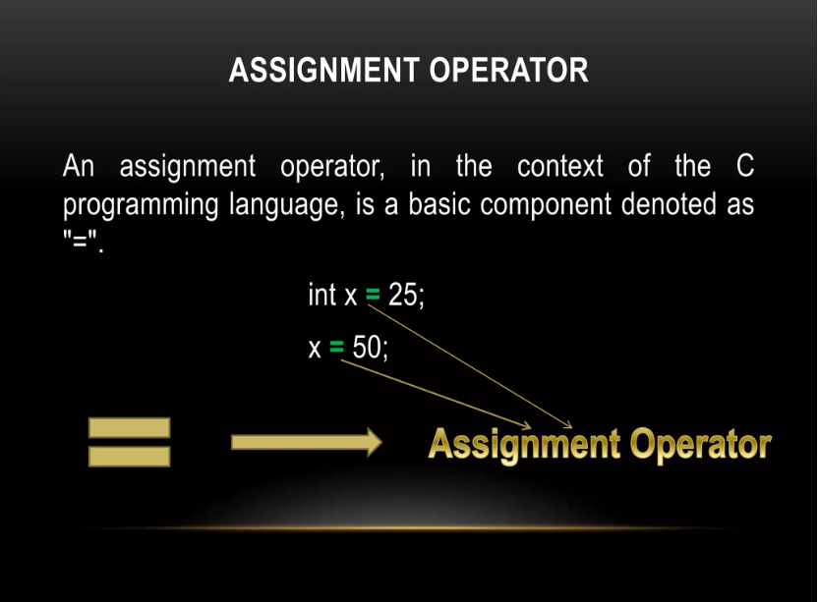


Slide 32
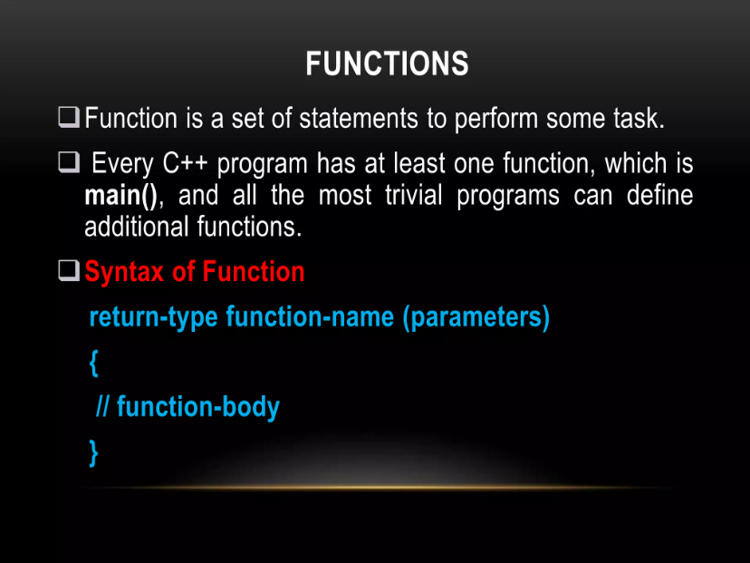
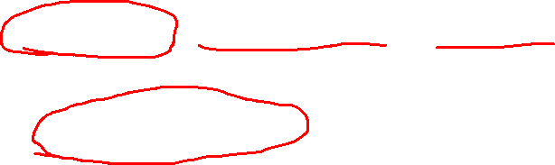

Slide 33
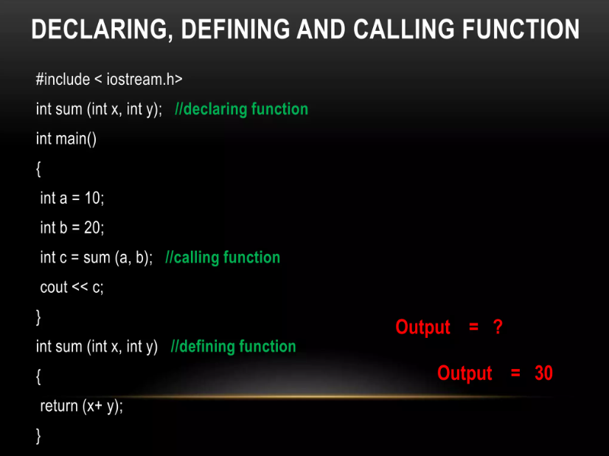
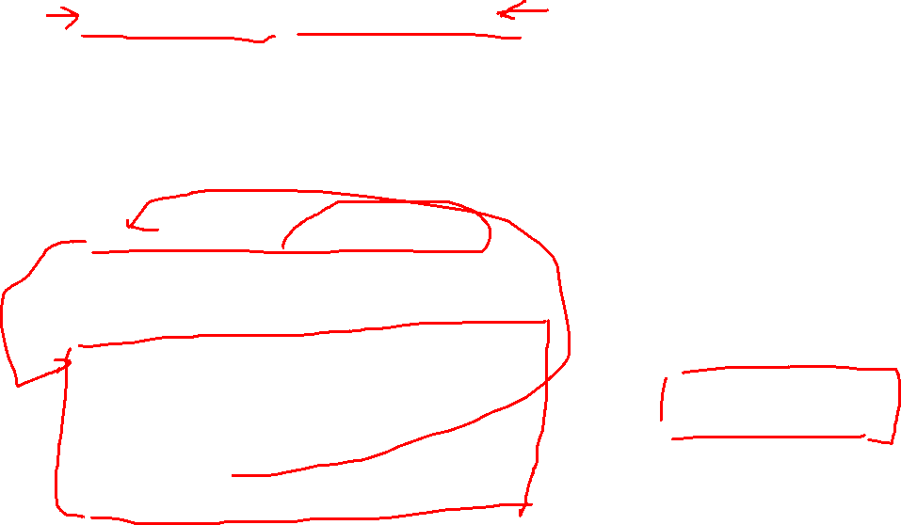

Slide 34
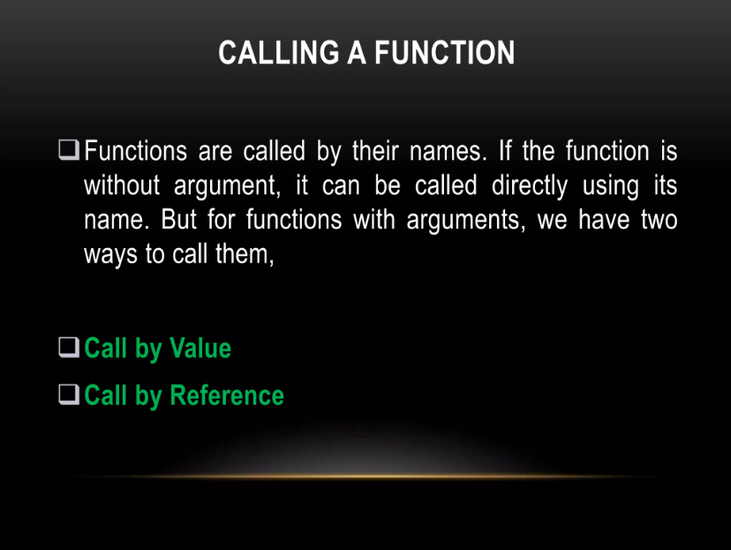


Slide 35
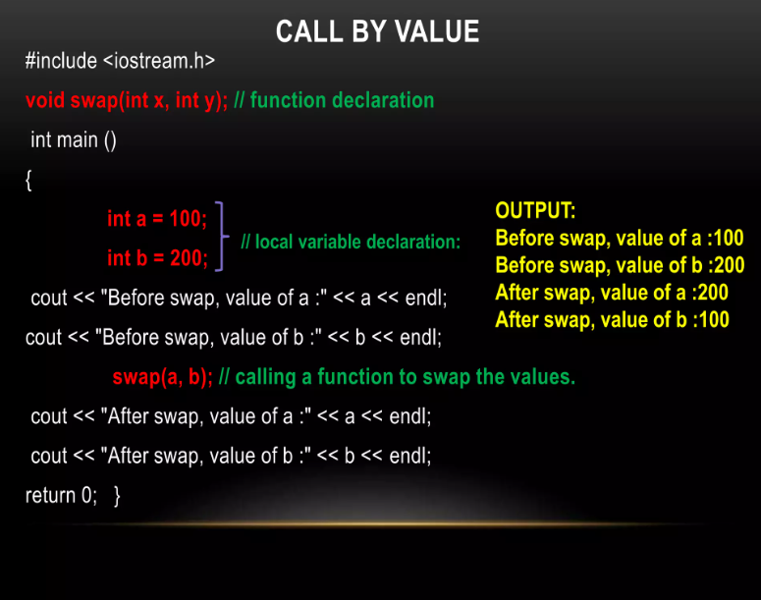
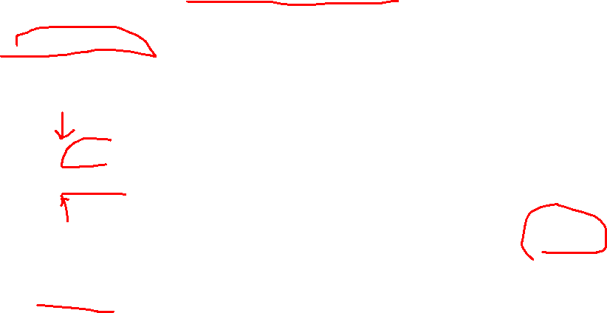

Slide 36
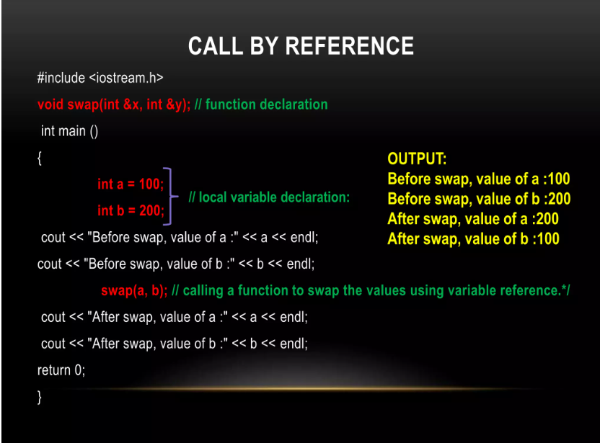
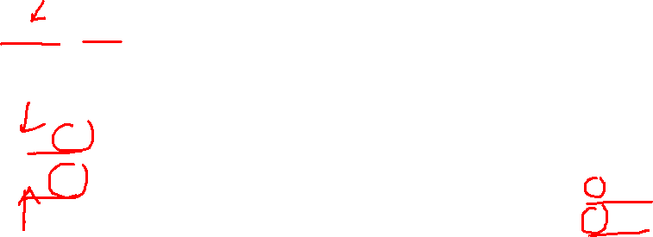

Slide 37
